Slide 1

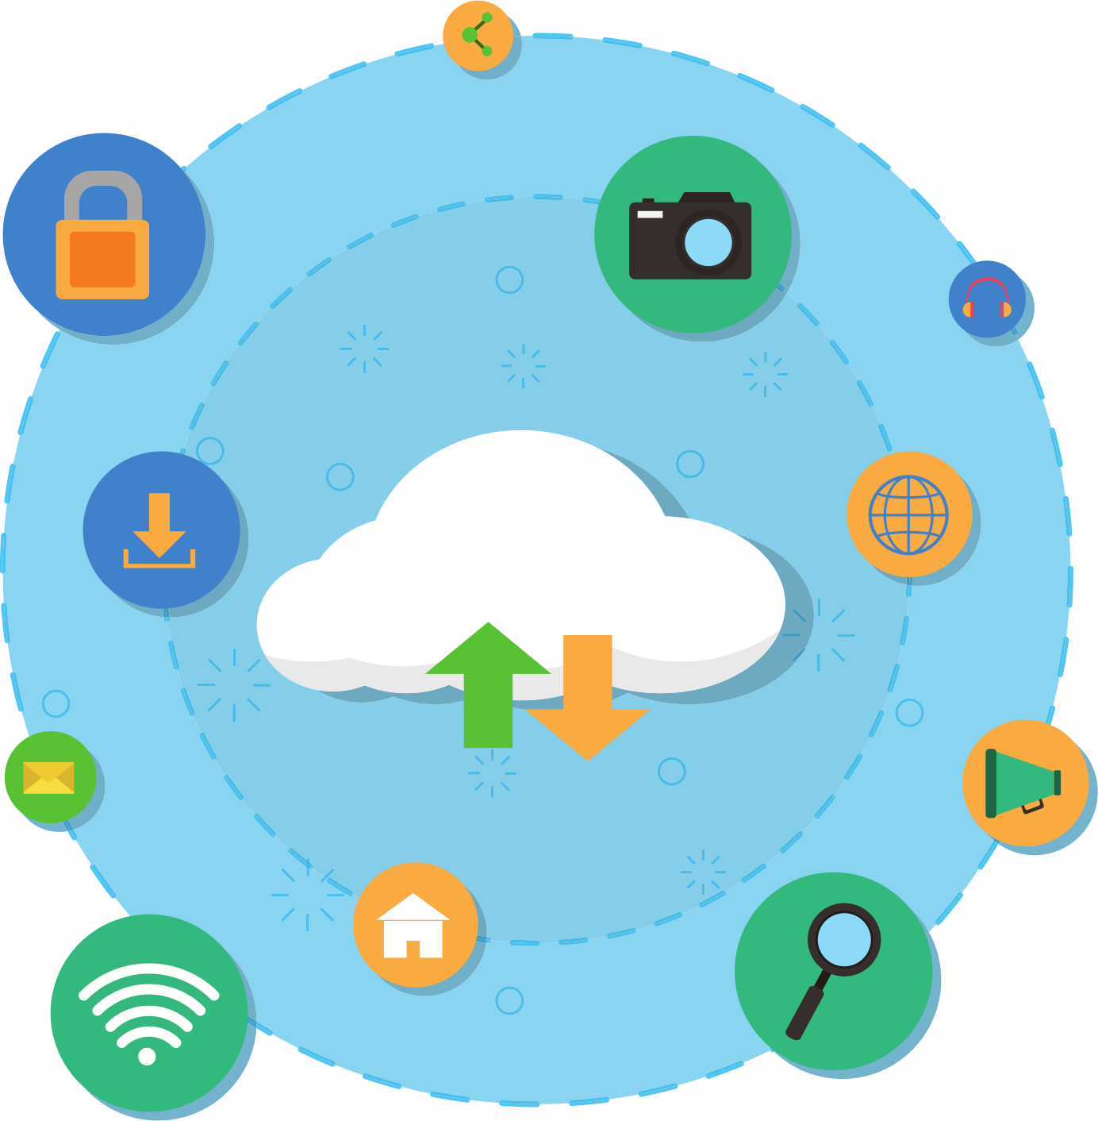
JUNE 15, 2024
EduCloud
Cloud Computing Project Presentation
BY TEAM 1

Slide 2












Team Member
Caihui Yang
Leni Jin
Atilla Karaali
Qiong Zhang
Shital Hinge
Akshat Jangam
Dhruv Basnotra
Maheswar Barrenkala
Xu Liu

Slide 3





Project Overview
Objective
Provide an efficient, user-friendly course registration and account management system targeting the education sector for students, staff, and administrators.
Background
With the rise of online education, schools need an efficient and secure system to manage user accounts and course registrations.
Target Audience
Students
Educational staff
Administrators

Slide 4







Key Functionalities
Login Functionality
Account Sign-Up: Supports creating accounts with distinct roles for students, staff, and administrators with specific access privileges.
Role-Specific Login: Secure login system supporting multiple user roles with role-specific dashboards and permissions.
Logout Functionality
Secure Session Termination: Ensures user sessions are securely terminated to prevent unauthorized access.
Notification System
Secure Messaging and Notification Channels: Securely transmit notifications and messages to prevent interception and unauthorized access.
Data Protection in Notifications: Ensure that sensitive information included in notifications is protected and only accessible to intended recipients
Course Registration System
Manual Course Registration: Allows users to register for courses through a dropdown list, simplifying the registration process.
Future Improvements: Plans for API integrations and a more advanced user interface.

Slide 5









Architecture Design Overview
Microservices Architecture
Auth Service: Manages authentication, uses Amazon RDS for user data.
Course Upload Service: Stores course data in DocumentDB and Amazon S3.
Course Search and Registration Service: Uses ElasticSearch for search, stores data in relational databases and Cassandra, utilizes cache for performance.
Notification Service: Sends notifications using Kafka for event-driven communication.
04
System Architecture
03
Includes web server, API gateway, authentication service, course management service, notification service, and database services.
Cloud Deployment
02
Design Topology
Uses AWS services (EC2, RDS, DocumentDB, S3).
Managed by Kubernetes for high availability and automatic scaling.
User task flow diagram from login to course registration and logout.
Service interaction sequence diagrams.
01

Slide 6
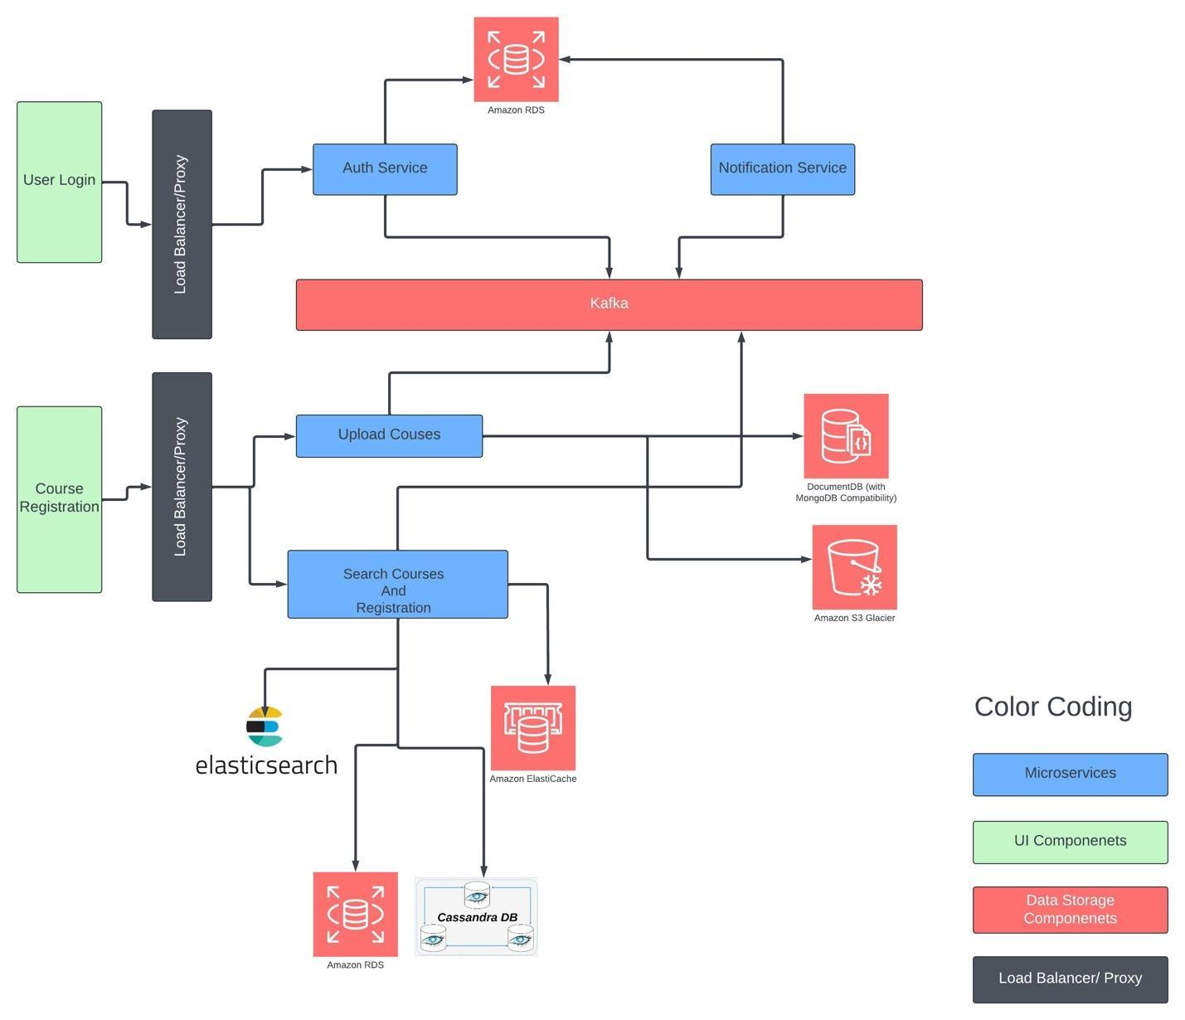
Design Architecture Topology

Slide 7
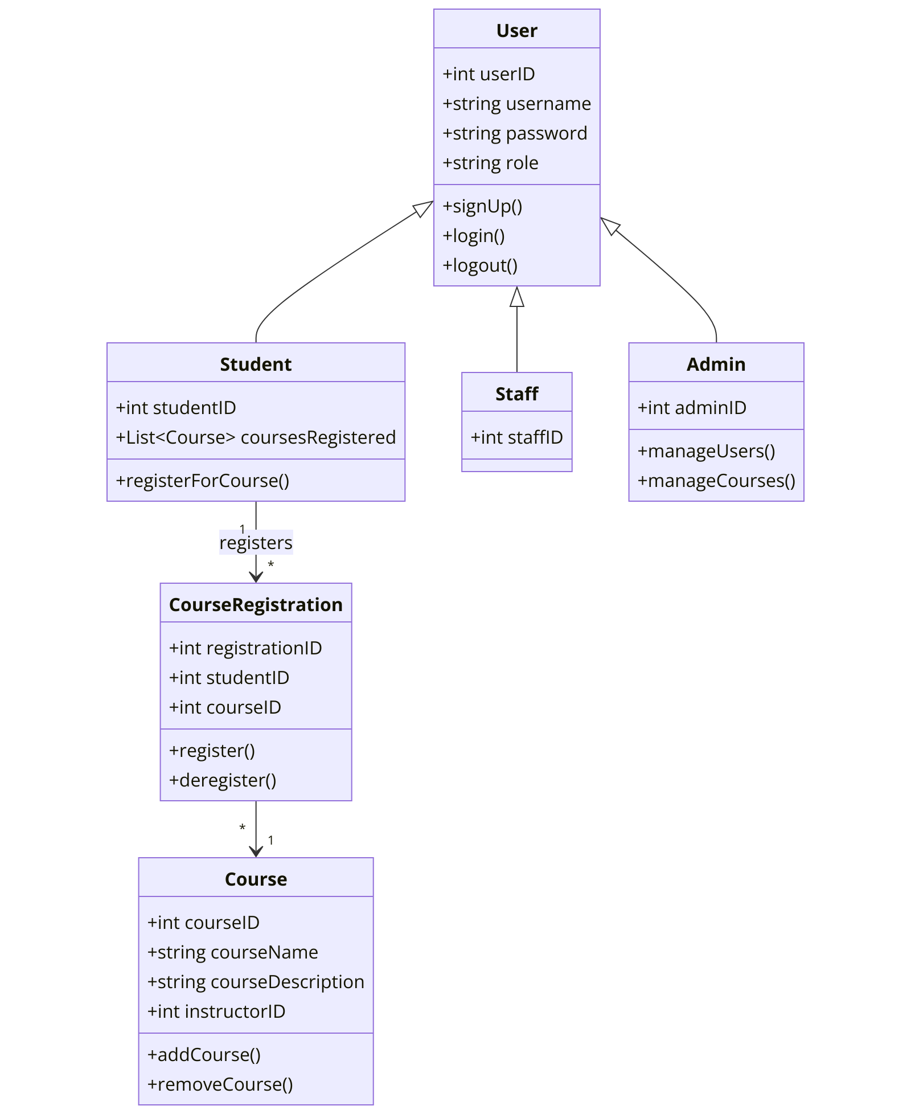
UML

Slide 8
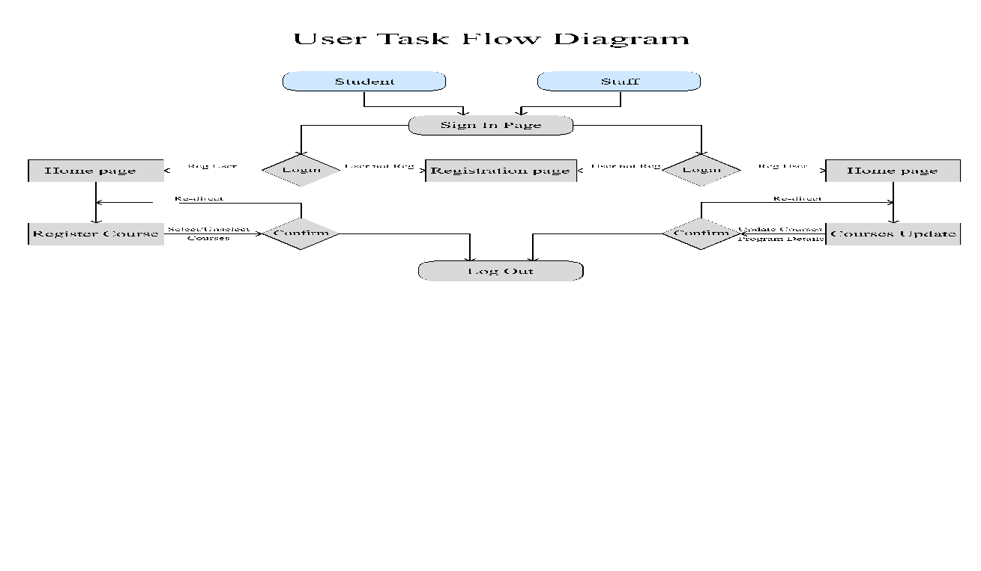
User Task Flow Diagram

Slide 9
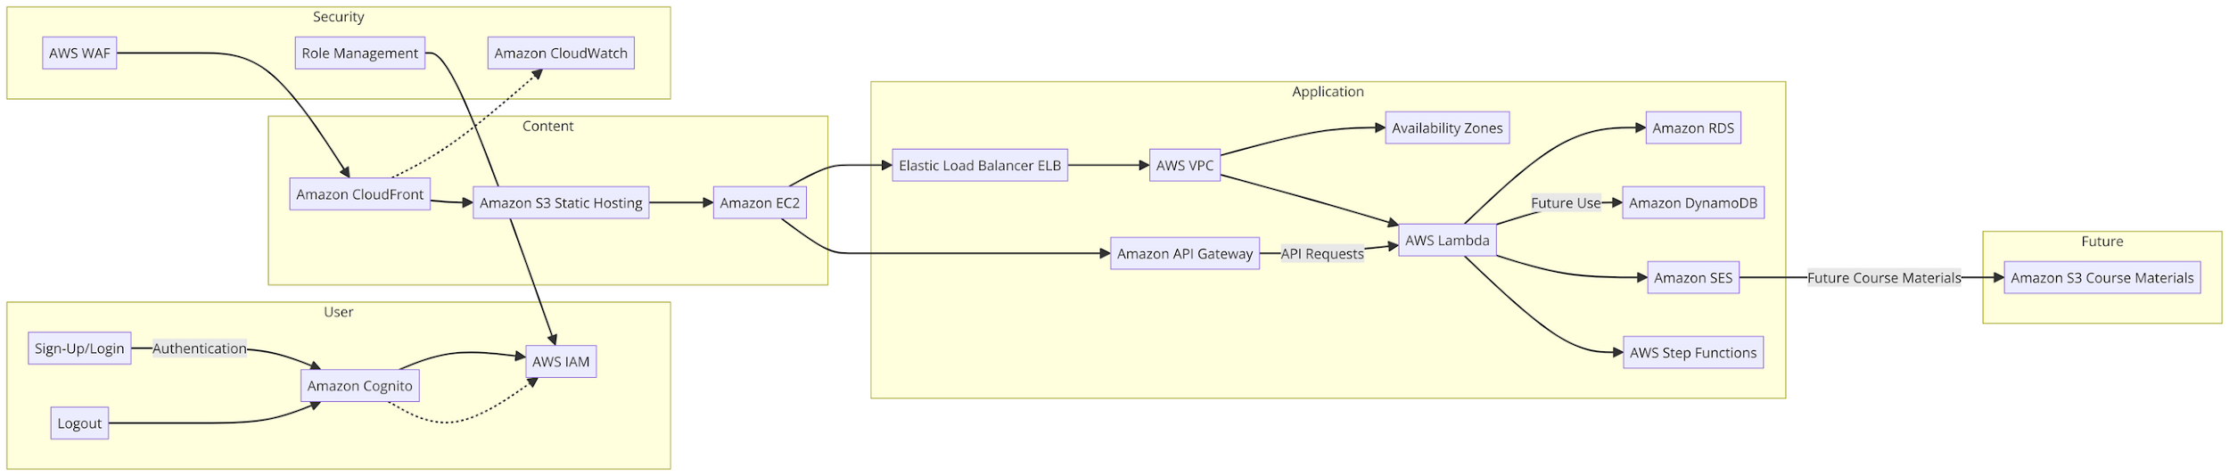
Design Architecture Topology

Slide 10




Estimating Cloud Resources
Compute Resources
Storage Resources
3 Web server instances (AWS EC2 r5.large) for handling frontend and API gateway
13 microservice instances (AWS EC2 r5.large) for running various microservices
RDS: 25GB for Auth service
MongoDB: 10GB for Course Upload service
Amazon S3: 500GB for storing course materials
RDS: 50GB for Course Registration service
Cassandra: 50GB for Course Registration service
ElastiCache: 1 instance (AWS ElastiCache cache.r5.large)
Network Resources
Additional Resources
2 Load Balancers (AWS Network Load Balancers)
1 Message Queue (Kafka) for inter-service communication

Slide 11
Orchestration with Kubernetes
Web Application Deployment
Purpose: Manages three replicas to ensure high availability and robustness against failures.
File: web-deployment.yaml
Database Deployment
Purpose: Maintains a single, persistent database pod to guarantee data integrity and continuous availability.
File: db-deployment.yaml
Web Service Configuration
Function: Directs traffic to web pods and facilitates external access via ingress, ensuring seamless connectivity.
File: web-service.yaml

Slide 12





Security and Compliance Strategies
- Security Measures -
Authentication and Authorization
Secure Development Practices
02
04
Multi-Factor Authentication (MFA)
Role-Based Access Control (RBAC)
Code Review and Testing
Vulnerability Management
Data Encryption
Network Security
01
Encryption in Transit (TLS)
Encryption at Rest (AES-256)
03
Firewalls
Intrusion Detection and Prevention Systems (IDPS)

Slide 13
Security and Compliance Strategies
- Compliance Strategies -
Regulatory Frameworks
Data Privacy
Accessibility Compliance
FERPA (Family Educational Rights and Privacy Act)
GDPR (General Data Protection Regulation)
CCPA (California Consumer Privacy Act)
Student Data Protection
Data Retention Policies
Student Data Protection
Data Retention Policies

Slide 14
Course Management System
Application-Specific Security Measures
01
Secure Registration and Drop Processes
Scheduling and Timetable Management Security
Our application-specific security measures are designed to ensure the confidentiality, integrity, and availability of critical educational data.
By implementing robust security protocols for the course management, grading, notification, and analytics systems, we ensure that all user interactions and data transactions are secure and compliant with industry standards.
This holistic approach to security helps protect sensitive information and enhances the overall trust and reliability of the system.
Grading System
Secure Submission and Review Mechanisms
Plagiarism Detection and Reporting Security
02
Notification System
03
Secure Messaging and Notification Channels
Data Protection in Notifications
Analytics System
Secure Data Aggregation and Analysis
Capacity Planning Security Measures
04

Slide 15
Implementation Plan
Security Policies
Monitoring and Improvement
Training and Awareness Programs
Develop and enforce security policies defining the security requirements and procedures for the application.
Regularly conduct training and awareness programs to promote security best practices and compliance.
Implement continuous monitoring and improvement processes to ensure the application remains secure and compliant with evolving regulations and threats.

Slide 16

Question and Answe﻿r...

Slide 17

Thanks For
Your Listening!
BY TEAM 1

